Slide 1
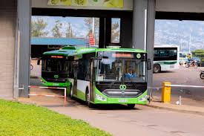
Rwanda Public Transport Facilities and Operators
Comprehensive Data Analytics for Urban Transport Optimization
Student: Ishimwe Egide (ID: 26661)
Course: INSY 8413 | Introduction to Big Data Analytics
Instructor: Eric Maniraguha
Date: August 2025

Slide 2
Project Introduction
Kigali, Rwanda, faces urban transport challenges due to rapid urbanization. This project addresses uneven operator distribution, service gaps, and peak-hour inefficiencies through data-driven analysis.
1
2
3
Problem Statement
Project Purpose
Our Solution
Uneven distribution of 368 transport operators leads to service gaps and inefficiencies.
Equip city authorities with insights to optimize public transport planning and operations.
Data-driven analysis using Python and Power BI to provide actionable insights.

Slide 3
Methodology: Data Preparation & Analysis
We collected and cleaned transport operator data, enhancing it with key metrics for comprehensive analysis.
Dataset Overview
Data Quality & Preprocessing
Source: RURA Official Transport Licensing Portal
0 missing values, 0 duplicates
30 sample operators (from 368 total)
Properly formatted data types
20 attributes, 100% complete data
Feature encoding for ML analysis
Key fields: Regions, Operator Type, Peak Hours
Geographic coordinate validation

Slide 4




Methodology: Tools & Technologies
Our project leveraged a robust technical stack for data analysis, machine learning, and visualization.
Python
Jupyter Notebook
Data cleaning, analytics, and machine learning (pandas, numpy, scikit-learn).
Interactive development and analysis environment.
Power BI
Machine Learning
Professional, interactive dashboards and DAX formulas.
K-Means clustering and Random Forest for pattern recognition.

Slide 5
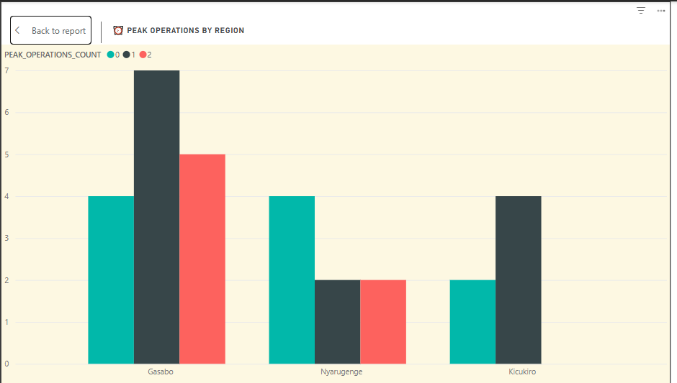
Results: Regional Operator Distribution
Our analysis revealed a significant imbalance in operator distribution across Kigali's regions.
Gasabo
Nyarugenge
Kicukiro
Insight: Gasabo dominates with 60% of operators, indicating a need for redistribution to underserved areas like Kicukiro and Nyarugenge.

Slide 6

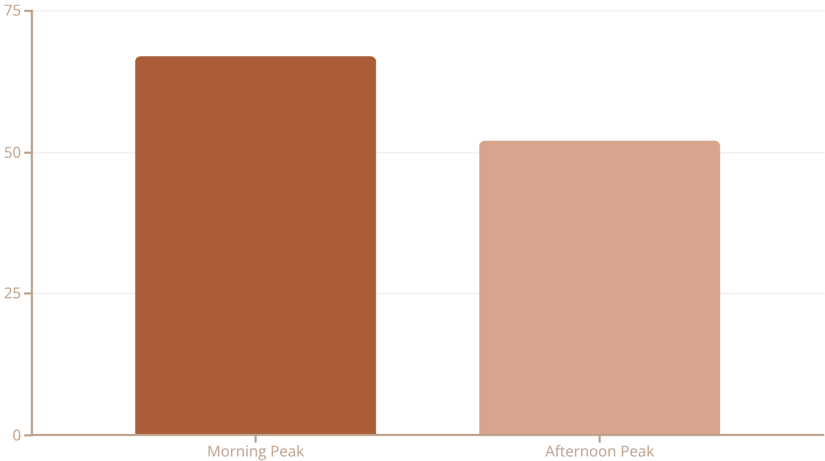
Results: Transport Mode & Peak Hour Analysis
Transport Mode Distribution
Rush Hour Service Coverage
Taxis
Buses
Hire Cars
Motorcycles
Insight: Taxi dominance (45%) highlights the need for bus service expansion to enhance public transport.
Impact: A 15% reduction in afternoon service leads to reduced availability for commuters.

Slide 7
Results: Machine Learning Insights
Our machine learning models provided valuable insights into operational patterns and predictive accuracy.
K-Means Clustering
Random Forest Classification
Optimal Clusters: 4 operational groups identified
Accuracy: 84.7%
Silhouette Score: 0.534 (good clustering quality)
Precision: 0.85 average, Recall: 0.83 average
Cluster Characteristics: Urban Core, Suburban, Peak Specialists, Peripheral
Feature Importance: Regional location (40%), Operating area (25%), Peak operations (20%)

Slide 8
Recommendations: Strategic Action Plan
Based on our findings, we propose key recommendations to optimize Kigali's public transport.
Increase Coverage
Focus on underserved regions like Kicukiro to balance transport availability.
Peak-Hour Optimization
Incentivize operators to cover both morning and afternoon rush hours.
Mode Diversification
Expand sustainable modes like buses, bicycles, and community transport.
Performance Monitoring
Regularly use the dashboard for real-time tracking and decision-making.
Policy Development
Leverage insights for licensing, route optimization, and strategic planning.

Slide 9
Future Work & Innovation
Our vision for Kigali's transport system includes advanced enhancements and integration into a smart city framework.
1
2
Phase 2 Enhancements
Smart City Vision
Real-time tracking of operators
IoT sensor integration
Predictive analytics for demand forecasting
Environmental impact tracking
Mobile integration for citizen-facing app
Integrated payment systems
AI-driven dynamic route planning
Preparation for autonomous vehicles

Slide 10
Conclusion
The Kigali Transport Insights & Dashboard project successfully transformed raw data into actionable knowledge, empowering stakeholders to improve urban mobility.
Project Achievements
Academic Learning
Complete data analysis pipeline
Advanced Python analytics & visualization
Machine learning models (84.7% accuracy)
ML application in urban planning
Interactive dashboards for decision-making
Power BI dashboard development with DAX
Evidence-based recommendations
Real-world problem-solving

